Slide 1

Time Series Analysis
Code Brigade

Slide 2
Takeaway from Today’s Session
1- Introduction to Time Series
2- Component of Time Series
3- Evaluation Metrics for Time Series
4- Forecasting
5- Hands-on
Time is of the essence.

Slide 3
What is Time Series?
Time Series data is an ordered sequence of values that collectively represents how a system, a process or even behaviour changes over time.
Goal of time series analysis is forecasting future values based on previously observed value. We can in short say that the past values influence present and future values.
Time series is concerned with analysis of data over time such as daily, weekly, monthly or yearly.
There are so many things we can do with time series out of which below are the few I am mentioning for you to be aware.
Analyse historical trends.
We can look at the state of the system at any point in time and try to visualise it to predict.
We can do real-time monitoring.
Troubleshoot problem as they appear (Example being COVID cases).
Identify and Fixing problem even before they appear.

Slide 4
When not to use Time Series?
1- When the values are constant over the period of time. Understand this, if we have values which is constant with the given amount of time, would it be feasible to use time series? Nah, I guess not so. The values are just not moving ahead. It is a flat line. We cannot analyse anything from that set of data. We would need to use some other feature in order to come up with any prediction and time series is not one of the models that we can use in this case.
2- Values can be represented using a known function. Well, in this case as well we cannot use time series.

Slide 5
Components of Time Series

Slide 6
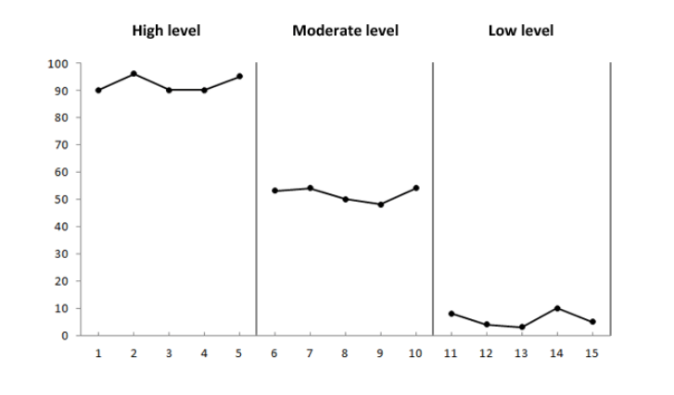
Level
Level component of time series is the position of the data set taken from Y-axis. Or, you can say, Level is the average value in the series.

Slide 7
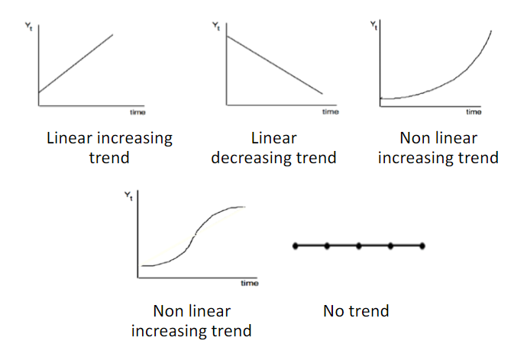
Trend
As the name itself clarifies, the trend component is a long-term gradual increase or decrease of data indicating direction of data as in where it is heading and what we can get from it. It can be defined as increasing or decreasing value in the series.

Slide 8
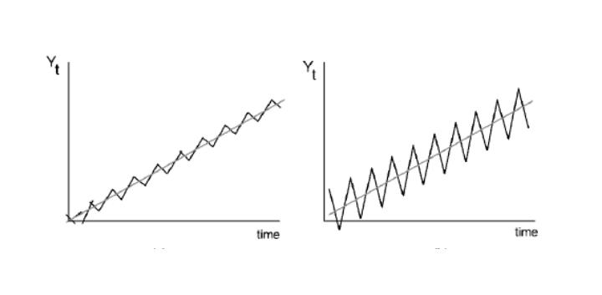
Seasonality
Seasonality is repeating short term cycle in the series. The pattern is repeated within the time frame of the year. The cola consumption example was a seasonal one as there is seasonal increase in consumption during Summer.

Slide 9
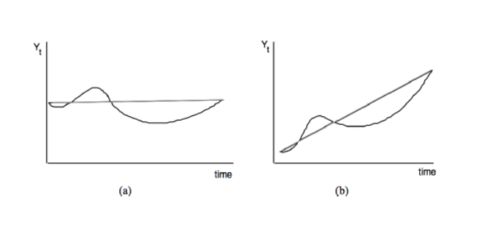
Cyclical
A gradual long term up and down potentially irregular swings of the data. The pattern repeats irregularly over time.

Slide 10
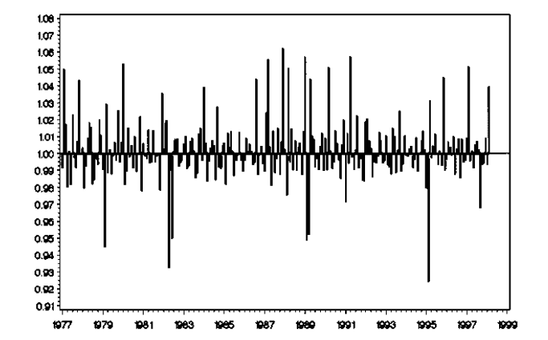
Random Error
A random increase or decrease of the data for the specific period of time. These are the kind of fluctuations that are neither systematic nor predictable.

Slide 11
Note:
Level and random error are the mandatory component of Time Series. Every Time series data will have some sort of level and random Error.
Trend, Cyclical and Seasonal are optional component. They may or may not exist is the time series dataset.

Slide 12
Decomposing a Time Series

Slide 13
Why do we need to decompose a time series?
Decomposing a time series can be thought of as a system which helps break time series into various components. You can think of a series as a whole i.e combination of time series components.
We decompose time series in order to extract vital patterns of time series data which are often difficult to detect through visual inspection. Also, it gives us the understanding of which of the components contribute the most or the least to the variance of time series data. And, once we get that understanding, we can either retain or remove such component depending on the contribution it will make towards modelling the time series data.

Slide 14
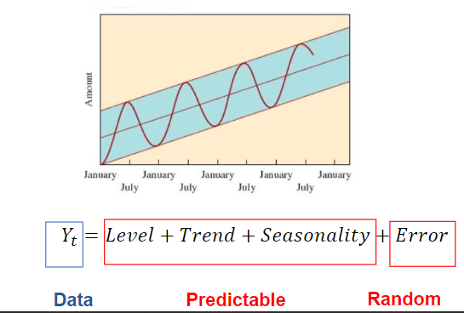
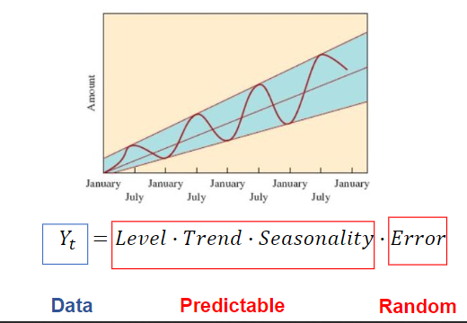
How do we decompose a Time Series?
Additive Model.
Additive model is used when the variance of the time series does not change over different values of time series or has a normal distribution with constant variance over time.
Multiplicative Model.
In the multiplicative model, the original time series is expressed as the product of trend, seasonal and irregular components. So, if the seasonal variation is increasing over time, we use this model of decomposition.

Slide 15
Moving Average
As wiki would have it, in statistics, a moving average (rolling average or running average) is a calculation to analyse data points by creating a series of averages of different subsets of the full data set. It is also called a moving mean or rolling mean and is a type of finite impulse response filter. Variations include: simple, and cumulative, or weighted forms.
Given a series of numbers and a fixed subset size, the first element of the moving average is obtained by taking the average of the initial fixed subset of the number series. Then the subset is modified by "shifting forward"; that is, excluding the first number of the series and including the next value in the subset.
Moving Average is a very important statistical component when it comes to time series.

Slide 16
Month | Expenses | Moving Average
Jan | 1000
Feb | 3000
Mar | 5000
Apr | 2500 | 3000
May | 3500 | 3500
Jun | 4000 | 3666.67
Jul | 2000 | 3333.33
Window Size = 3

Slide 17
Evaluation Metrics for Time Series

Slide 18
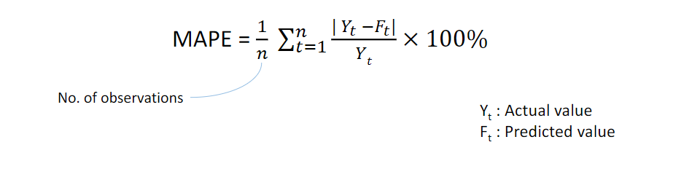
Mean Absolute Percentage Error
It is a measure of prediction accuracy of a forecasting method in statistics, for example in trend estimation, also used as a loss function for regression problems in machine learning. It is given by formula:

Slide 19
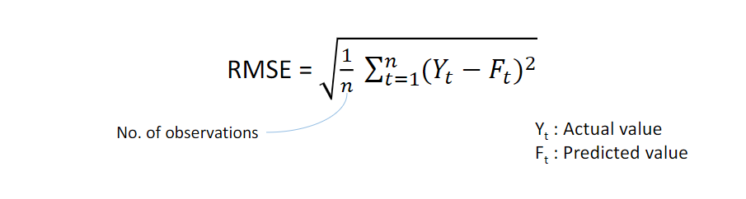
Root Mean Squared Error
The root-mean-square deviation (RMSD) or root-mean-square error (RMSE) is a frequently used measure of the differences between values (sample or population values) predicted by a model or an estimator and the values observed. Lower RMSE implies better prediction. However, it also depends on the scale of the data.

Slide 20
Stationary VS Non Stationary Time Series
A stationary (time) series is one whose statistical properties such as the mean, variance and autocorrelation are all constant over time. Hence, a non-stationary series is one whose statistical properties change over time.
In order to work with Time Series, you must have a Stationary Dataset. If in case you have Non-Stationary dataset, it must first be converted to Stationary dataset (for example by trend removal), so that further statistical analysis can be done on the de-trended stationary data. This is so because let’s say for example, if the series we have is consistently increasing over time, then the sample mean and variance will grow with the size of the sample, and they will always underestimate the mean and variance in future periods. The usual mean of “de-trending” a series is to fit a regression line and then subtract it from the original data.
To be honest, most of the statistical forecasting methods are based on the assumption that the time series dataset is stationary. And also, a stationary series is easy to predict.

Slide 21
How to make a Time Series Stationary?
In order to make any time series stationary, we perform differencing.
Differencing is a method of transforming a non-stationary time series into a stationary one. This is an important step in preparing data to be used in an ARIMA model. So, how does it work?
The first differencing value is the difference between the current time period and the previous time period. If these values fail to revolve around a constant mean and variance then we find the second differencing using the values of the first differencing. We repeat this until we get a stationary series.

Slide 22
What is Correlation?
Correlation denotes association between two variables.
For example, let’s say how Salary hike is correlated with Expense. We can say that more the salary, more the expense. We assumed this, but that’s what correlation is. How both variables are associated with each other.

Slide 23
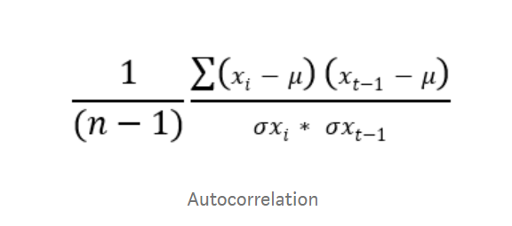
What is Auto-Correlation?
According to wiki, Autocorrelation, also known as serial correlation, is the correlation of a signal with a delayed copy of itself as a function of delay. Informally, it is the similarity between observations as a function of the time lag between them. That’s some heavy definition. Okay, let me cut it short and simple. Autocorrelation is correlation with itself. I mean, how the variable is related or associated with itself. It is also called serial or lagged correlation.
Autocorrelation can be defined as the correlation between itself and the other values of same variable(features) (in our case correlation between (Xt and Xt-1) (Xt and Xt-2). etc…) and it is denoted as ρ.

Slide 24
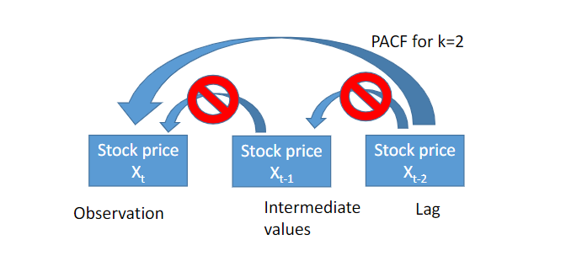
Partial Auto-Correlation
The partial autocorrelation at lag k is the correlation that results after removing the effect of any correlations due to the terms at shorter lags. Okay, in normal terms, PACF is conditional Correlation. It is just like an interviewer asking you What was your contribution to making of the whole project.
In autocorrelation we find correlation between present(xt) and next (xt-1) values. Partial Autocorrelation is finding the correlation between present(xt) random lags value (xt-h) so, the correlation in the middle values like (xt-1) (xt-2) (xt-3) …. (xt-(h-1)) will not be taken into account.

Slide 25
White Noise
A time series is white noise if the variables are independent and identically distributed with a mean of zero. This means that all variables have the same variance (sigma^2) and each value has a zero correlation with all other values in the series.
Predictability:
If at all there is white noise in your time series, that means by definition it is random. What I mean is that the things are happening at random and you cannot make predictions or reason with it. Still did not get it. Let’s understand with an example. We are under attack from a virus. Let’s just assume one day that government says, there is no virus at all. And one day they say, these many people got infected. I meant, there is no fix series of things occurring, virus is coming and going at random. Would you be able to make prediction? Wouldn’t it be very hard? This is what White noise does. Predicting things becomes harder.
Model Diagnostics:
The series of errors from a time series forecast model should ideally be white noise. When forecast errors are white noise, it means that all of the signal information in the time series has been harnessed by the model in order to make predictions. All that is left is the random fluctuations that cannot be modelled.

Slide 26
Autoregressive Model
An autoregression (AR) model predicts future behaviour based on past behaviour. It’s used for forecasting when there is some correlation between values in a time series and the values that precede and succeed them. You only use past data to model the behaviour, hence the name autoregressive. The process is basically a linear regression of the data in the current series against one or more past values in the same series.
In an AR model, the value of the outcome variable (Y) at some point t in time is like “regular” linear regression directly related to the predictor variable (X). Where simple linear regression and AR models differ is that Y is dependent on X and previous values for Y.

Slide 27
Moving Average Model(MA)
According to Wiki, in time series analysis, the moving-average model (MA model), also known as moving-average process, is a common approach for modelling univariate time series. The moving-average model specifies that the output variable depends linearly on the current and various past values of a stochastic (imperfectly predictable) term.

Slide 28
ARIMA Model
ARIMA Model is a combination of AR and MA model. ARIMA, short for ‘Auto Regressive Integrated Moving Average’ is actually a class of models that ‘explains’ a given time series based on its own past values, that is, its own lags and the lagged forecast errors, so that equation can be used to forecast future values.
The model comprises of 3 components:
p is the order of AR term.
q is the order of MA term.
d is the number of differencing.
We can fit ARIMA Model on data using the value of (p,d,q) obtained and make prediction.

Slide 29
Links:
https://github.com/njain5/datasciencecode
https://www.linkedin.com/in/nikhiljain93/
References:
https://www.wikipedia.org/
https://towardsdatascience.com/
https://www.analyticsvidhya.com/
https://www.machinelearningplus.com/

Slide 30
Thank You
Code brigade

